Slide 1
Digital Portfolio
STUDENT NAME: Alina Harmin Z
REGISTER NO AND NMID: 31224U09009
DEPARTMENT: BCA
COLLEGE: COLLEGE/ UNIVERSITY
Islamiah Women's Arts and Science College

Slide 2
PROJECT TITLE MODERN AND TECHY PORTFOLIO

Slide 3


AGENDA
Problem Statement
Project Overview
End Users
Tools and Technologies
Portfolio design and Layout
Features and Functionality
Results and Screenshots
Conclusion
Github Link
3/21/2024 Annual Review

Slide 4

PROBLEM STATEMENT
In the digital age, traditional resumes and portfolios lack interactivity and often fail to showcase technical and creative capabilities effectively. Many individuals struggle to present their skills and projects in a way that stands out online.

Slide 5

PROJECT OVERVIEW
This project is a personal portfolio website developed using HTML, CSS, and JavaScript. Its purpose is to showcase personal and professional achievements, skills, and completed projects. It acts as a digital resume and branding platform that helps users present themselves to potential employers, clients, or collaborators in a visually appealing and interactive format.

Slide 6

WHO ARE THE END USERS?
Job recruiters and employers looking to evaluate skills and previous work. Freelance clients searching for talent and relevant experience. Peers and collaborators interested in networking or partnerships. General viewers seeking inspiration or information about the individual.

Slide 7

TOOLS AND TECHNIQUES
Authoring: VS Code, Git/GitHub (Pages for hosting). HTML/CSS/JS standards: semantic HTML, Flex/Grid, progressive enhancement. MDN Web Docs Quality: Lighthouse/Core Web Vitals; image optimization; lazy-loading.

Slide 8
POTFOLIO DESIGN AND LAYOUT
Home Section: Introduction and welcome message with a hero image. About Section: Short bio, skills overview, and education background. Projects Section: Showcases past projects with images and links. Contact Section: Includes a contact form with validation and direct messaging. Navigation: Sticky navbar with smooth scrolling for better UX. Responsive Layout: Works across desktop, tablet, and mobile devices.
8

Slide 9
FEATURES AND FUNCTIONALITY
Interactive navigation bar with active state highlighting. Dynamic project gallery with hover effects. Contact form with real-time input validation. Dark/Light mode toggle (optional) for user preference. Scroll-based animations to enhance engagement. Downloadable resume or CV link. Smooth transitions and hover effects using CSS and JS.*

Slide 10
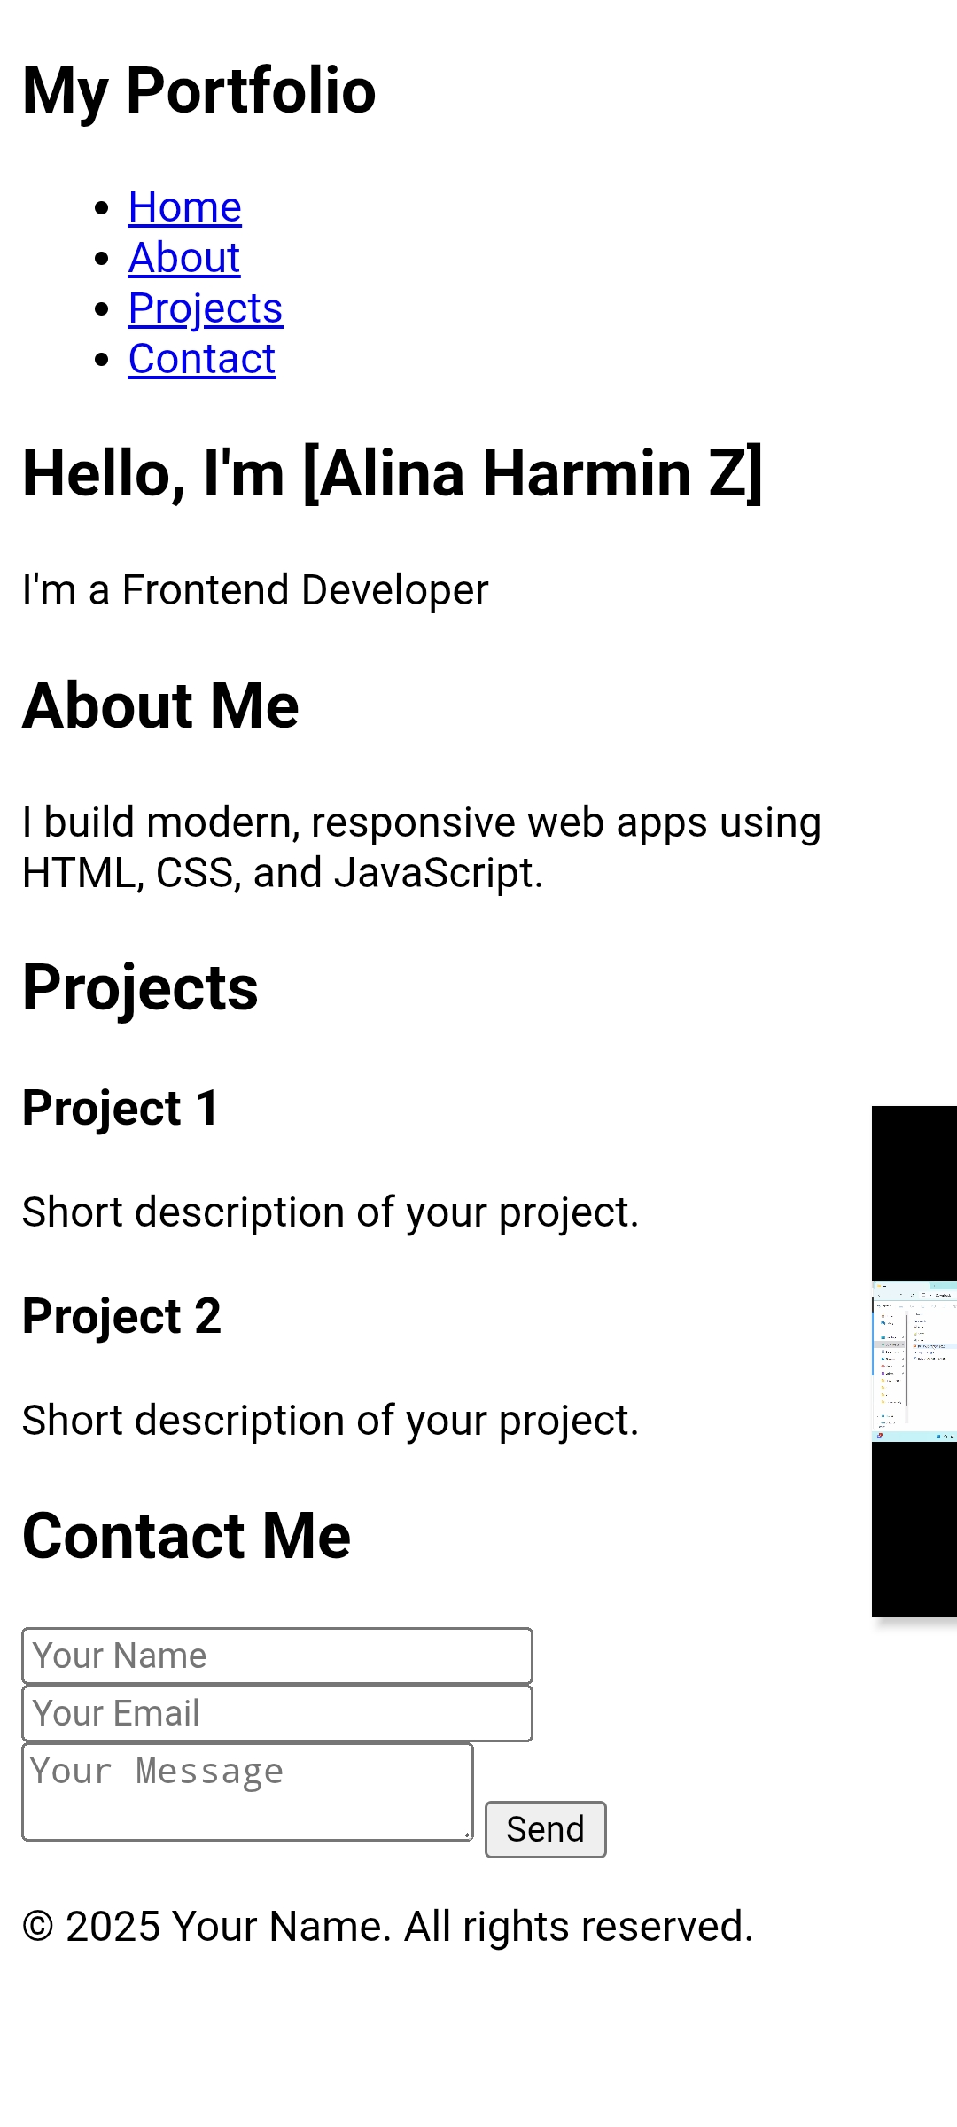

RESULTS AND SCREENSHOTS
3/21/2024 Annual Review
10

Slide 11
CONCLUSION
This portfolio project successfully demonstrates how HTML, CSS, and JavaScript can be used to build a professional, interactive, and responsive website. It not only helps users market themselves effectively but also acts as a live demonstration of their front-end development skills. With continued updates and improvements, it can serve as a long-term personal branding tool.
11

